Slide 1
SYR-CCDC
Saturday Event
tinyurl.com/scorebot

Slide 2
SYR-CCDC
Linux Basics
Alex Rydzak adrydzak@syr.edu

Slide 3
Goals:
- Cover very basic FAQ typically asked of me about Linux.
- Common misconceptions.
- CLI vs. GUI
- Bridging the world of CLI and GUI
- The Distro Divide
- Software (how to install, where does it come from?) - Updates - Firewalls (does it haz? spoiler alert: yes)

Slide 4

Linux:
- Myth: Linux is scary.
- Myth: Linux is only for super nerds.
- Myth: Linux is more secure than Windows.
- It’s just a different way of approaching
the same goals.
- Like all things, get better with practice.
- Pros and cons.

Slide 5
Basix:
- Linux is generally maintained by volunteers. “community focus.”
- Large companies will often contribute to the code base.
- Cheap licensing costs compared to Windows. (many times Linux is FREE)
- Often used for server operating systems for a plethora of reasons.

Slide 6
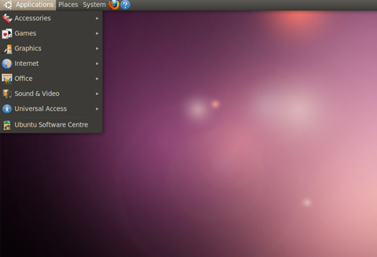
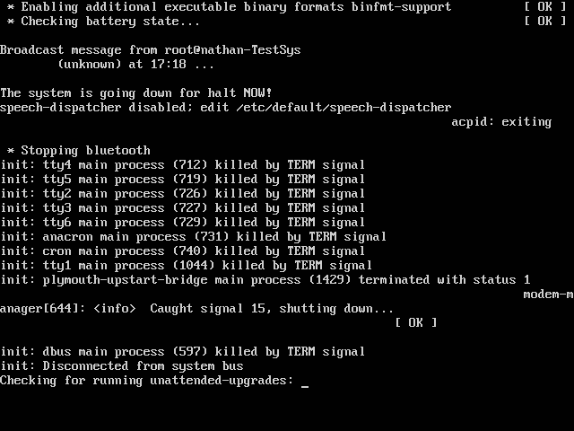
Basix:
< SAME THING >
- GUI vs. CLI: you will see both.
- In the “real world” servers run CLI.

Slide 7
GUI (graphical user interface):
- Same functionality as a server, just prettier and “easier to work with”
- Possible larger attack vector, more things to exploit.
- Can be bogged down, lots of unnecessary programs. (don’t need Solitaire to run a webserver)

Slide 8
CLI (command line interface):
- Simpler interface, easier to get to essential functions.
- More powerful for advanced users.
- Powerful controls over commands. Customize what comes back from running things.
- Ease of scripting.
- Need to get comfortable with
commands. Lots of CCDC stuff
revolves around commands.

Slide 9
The Bridge:
- Because the GUI is built on top of CLI functionality, the same features can be accessed. - Typically a program called “Terminal” or other similar type name can be used to interact directly with the CLI interface from within a GUI.
- OSX users, your OS is built partially off Unix, you can use Terminal and interact with the awesome CLI interface under the pretty shiny stuff.

Slide 10
The Distro Divide:
- Complicates CCDC prep.
- There are different “flavors” of Linux, often referred to as “distros” or distributions.
- The issue is that these distros are often built from a common platform.
- 1 platform may have 6-10 different distros built under it. - Results in things being in different places, different commands, etc.

Slide 11
The Distro Divide:
- 2 main players in the server platform space: - Debian platform
- Ubuntu distro
- Mint distro
- RedHat platform
- Scientific Linux distro
- CentOS distro (winning!)
- CCDC: last year, Ubuntu distro + outliers.

Slide 12
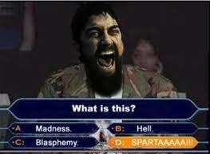
The Distro Divide:
- CCDC has outliers: - Arch Linux?
- OpenSUSE????
- CentOS is the most popular server OS in the “real world”
but didn’t appear at all last year.
- Complicates preparation work (did I mention that already?)

Slide 13
Software:
- Linux uses a system called “package management” to ease installation of software. - There are built-in lists of software that can be installed just by asking the computer via the Terminal.
- Ubuntu and Debian platform uses the apt-get syntax: apt-get install wireshark
- CentOS and RedHat platform uses the yum syntax: yum install wireshark

Slide 14
Software:
- Packages can also be installed manually if they are not in a list.
- Download the zipped file (typically .tar.gz file)
- Unzip, just like on a Windows box (via command line)
- Run the installer (generally a script of some kind, not a .EXE file)

Slide 15
Updates:
- Systems can be updated super easy. Most Linux distros come with core files saved in the package manager.
- Just invoke similar commands we used for installing software:
- Ubuntu and Debian platform uses the apt-get syntax: apt-get update
- CentOS and RedHat platform uses the yum syntax: yum update

Slide 16
Firewalls:
- iptables is a widely used firewall in Linux.
- Many front-end GUIs and other programs build off of.
- Direct interaction is possible, and desirable.
- Extreme amount of functionality:
- Temporary bans, perma-bans, awesome rule syntax.
- IPTABLES IS KEY TO CCDC LINUX
- Separate presentation(s) covering it later on...

Slide 17
Finally:
- Please please please: don’t be discouraged!
- There is SO much to learn. Anyone here who considers themself a Linux expert is WRONG.
- I love noobies.
- If you are interested but intimidated, let’s talk. - No question too small! - I love people with skills. - If you know this stuff, let’s talk!

Slide 18
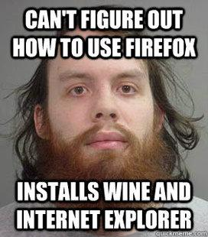

Questions:
- Linux general questions? Friend requests?
Suggestions on how to improve my material? (email me: adrydzak@syr.edu)

